Slide 1
Overview of the Compiler
Presented by: Foram Thakor

Slide 2
Overview
Simple Compiler
Difference Between Compiler, Interpreter & Assembler
Types of Compiler
Analysis of the Source Program
The Phases of a Compiler
The Grouping of Phases
Frontend and backend of compiler
Parsing Techniques
Code optimization Techniques.

Slide 3
Simple Compiler
A compiler is a software that converts the the high-level language to machine/binary language.
A computer program that translates computer code written in one programming language (the source language) into another language (the target language).
Typically translates high-level programming languages to low-level languages like assembly language, object code, or machine code to create an executable program.
Includes cross-compilers, bootstrap compilers, decompilers, source-to-source compilers, rewriters, and compiler-compilers.
The outputted machine code is made up entirely of binary bits -- 1s and 0s -- so it can be read and executed by the processors on the target computers.

Slide 4
Simple Compiler (Contd.)
Compilers are sometimes confused with programs called interpreters.
Although the two are similar, they differ in important ways. Compilers analyze and convert source code written in languages such as Java, C++, C# or Swift.
They're commonly used to generate machine code or bytecode that can be executed by the target host system.
Interpreters do not generate IR code or save generated machine code.
They process the code one statement at a time at runtime, without pre-converting the code or preparing it in advance for a particular platform.
Interpreters are used for code written in scripting languages such as Perl, PHP, Ruby or Python.

Slide 5
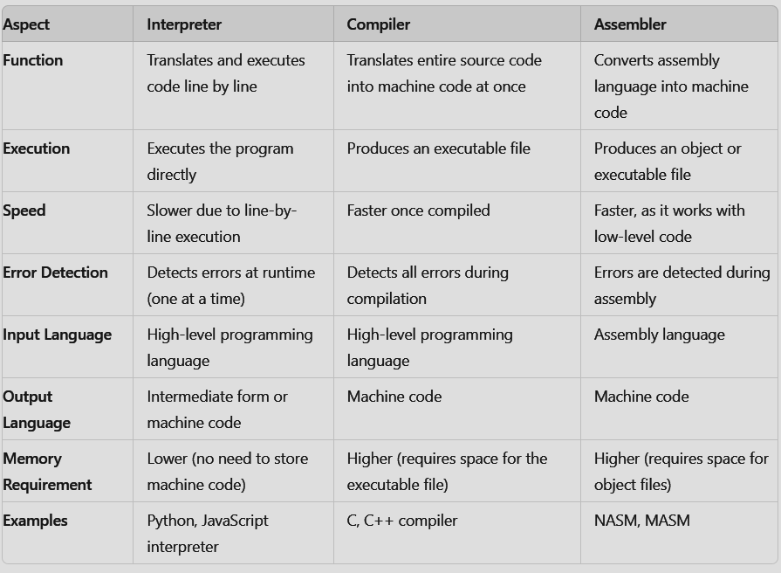
Difference Between Interpreter, Compiler & Assembler

Slide 6
Types of Compilers
Single Pass Compiler
A compiler that scans the entire source code only once to perform the compilation process.
All phases of the compiler are merged into a single module.
The source code is converted into machine code in a single pass.
Advantages: Fast compilation.
Disadvantages: Limited in scope for code optimization and error detection.
Example: Early FORTRAN compilers.

Slide 7
Types of Compilers (Contd.)
2. Multi Pass Compiler
A compiler that makes multiple passes over the source code to perform different tasks like syntax analysis, optimization, and code generation.
The source code or syntax tree is processed multiple times by the compiler.
It breaks down the program into smaller parts and processes them concurrently.
It generates multiple intermediate codes, with each pass using the output of the previous phase as input.
Advantages: Allows for better optimization and error checking.
Disadvantages: Slower compared to single-pass compilers.
Example: Modern C compilers.

Slide 8
Types of Compilers (Contd.)
3. Cross Compiler
A compiler that generates machine code for a platform other than the one it is running on.
Allows compiling code for a different platform than the one the compiler is running on.
Useful for developing software for multiple platforms or new hardware.
Use Case: Compiling code on a development machine (e.g., a PC) that is meant to run on another platform (e.g., an embedded system).
Example: ARM cross-compilers for embedded systems.

Slide 9
Types of Compilers (Contd.)
4. Source-to-Source Compiler
Converts one high-level programming language into another.
Translates source code in one high-level language to another high-level language.
Used for tasks like automatic parallelization, language migration, or adding annotations.
Use Case: Converting old code to a new language or generating code for a different language ecosystem.
Example: TypeScript to JavaScript, or CoffeeScript to JavaScript.

Slide 10
Types of Compilers (Contd.)
5. Just-In-Time Compiler
Compiles code at runtime, rather than before execution, often used to optimize performance in dynamic or interpreted environments.
Compiles programs at runtime, as they are executed.
Faster than traditional compilers and helps reduce program size by eliminating redundant code.
Improves performance by compiling "hot" code paths that are frequently executed.
Advantages: Improved performance by compiling frequently executed code at runtime.
Disadvantages: May introduce runtime overhead.
Example: Java Virtual Machine (JVM), .NET Common Language Runtime (CLR).

Slide 11
Analysis of the Source Program
The analysis of a source program is a crucial phase in the compilation process.
It involves breaking down the source code into its constituent parts and creating an intermediate representation that can be further processed.
This analysis phase typically consists of three main components: lexical analysis, syntax analysis, and semantic analysis.
(PLEASE REFER TO UNIT:2 PPT FOR THIS TOPIC)

Slide 12
The Phases of Compiler
Each phase of a compiler plays a crucial role in transforming high-level source code into executable machine code.
The phases of a compiler can be broadly divided into two parts: Analysis and Synthesis.
By breaking down this process into distinct stages—lexical analysis, syntax analysis, semantic analysis, intermediate code generation, optimization, and code generation—compilers can effectively manage complexity and ensure correctness at each step.
This structured approach allows for efficient error detection and enhances overall program performance.

Slide 13
The Phases of Compiler (Contd.)
Lexical Analysis (Scanner)
Task: This phase reads the source code as a stream of characters and groups them into meaningful sequences called tokens.
Input: The source program (as a character stream).
Output: A sequence of tokens (keywords, identifiers, operators, etc.).
Example: The string "int x = 10;" would be broken into tokens like "int", "x", "=", "10", ";".
Syntax Analysis (Parser)
Task: This phase checks if the sequence of tokens follows the grammar rules of the programming language. It builds a hierarchical structure known as a syntax tree (or parse tree).
Input: A sequence of tokens (from the lexical analyzer).
Output: A parse tree representing the grammatical structure of the source code.
Example: For the expression "x = 10;", the parse tree would show that this is an assignment statement.

Slide 14
The Phases of Compiler (Contd.)
3. Semantic Analysis
Task: This phase checks for semantic errors and ensures that the code is meaningful. It verifies whether the operations are valid (e.g., type-checking), ensuring that variables are properly declared and used.
Input: The parse tree (from the syntax analyzer).
Output: A syntax tree annotated with semantic information, often called an abstract syntax tree (AST).
Example: In the statement "x = 10;", it checks that the variable x has been declared and that 10 is compatible with the type of x.
4. Intermediate Code Generation
Task: In this phase, the compiler translates the syntax tree into an intermediate representation (IR) of the source code. The IR is closer to machine code but still independent of the target machine.
Input: The abstract syntax tree.
Output: Intermediate code (e.g., three-address code).
Example: The statement "x = 10;" could be translated into an intermediate code like t1 = 10, x = t1.

Slide 15
The Phases of Compiler (Contd.)
5. Code Optimization
Task: The intermediate code is optimized to improve efficiency. This can involve removing redundant operations, minimizing memory usage, or reducing the number of instructions.
Input: The intermediate code.
Output: Optimized intermediate code.
Example: Unnecessary or repeated calculations can be removed, such as eliminating redundant assignments or expressions.
6. Code Generation
Task: In this phase, the optimized intermediate code is translated into the target machine code (assembly or binary code). This phase considers the architecture of the target machine, generating code that can be executed.
Input: Optimized intermediate code.
Output: Target machine code (assembly or binary instructions).
Example: For an x86 architecture, the statement "x = 10;" may result in machine instructions to load the constant 10 into a register and store it in memory.

Slide 16
The Grouping of Phases
The grouping phase in the context of compilers refers to the organization of the compilation process into distinct segments or phases, typically categorized as front-end and back-end.
This classification helps streamline the compilation process and manage complexity effectively.
This grouping helps manage the complexity of the compilation process and allows different parts of the compiler to focus on specific tasks like code analysis, optimization, and machine-dependent code generation.
The grouping phase in compilers organizes the compilation process into front-end and back-end components, facilitating modularity, reusability, and simplified debugging.

Slide 17
The Grouping Phase (Contd.)
Importance of the grouping phase:
Modularity: Grouping phases into front-end and back-end allows for better organization and modularity in compiler design. Each phase can be developed, tested, and maintained independently.
Reusability: The front-end can be reused with different back-ends for various target architectures, allowing for greater flexibility in compiler design.
Simplified Debugging: Isolating different phases makes it easier to identify and fix errors since each phase has a specific responsibility.

Slide 18
Frontend and Backend of a Compiler
Front-End:
Purpose: The front-end is responsible for analyzing the source code and ensuring it adheres to the language's syntax and semantics. This part of the compiler is machine-independent.
Phases Included:
Lexical Analysis: Converts source code into tokens.
Syntax Analysis (Parsing): Checks the sequence of tokens against grammatical rules and constructs a parse tree or abstract syntax tree (AST).
Semantic Analysis: Validates the semantics of the code, ensuring that operations are meaningful (e.g., type checking).
Intermediate Code Generation: Transforms the AST into an intermediate representation that is easier to optimize and translate into machine code.
Error Handling: The front-end also includes error detection and reporting mechanisms for syntax and semantic errors.

Slide 19
Frontend and Backend of a Compiler (Contd.)
Back-End:
Purpose: The back-end focuses on generating target machine code from the intermediate representation. This part of the compiler is machine-dependent.
Phases Included:
Code Optimization: Improves the intermediate code to enhance performance (e.g., reducing execution time or memory usage).
Code Generation: Converts optimized intermediate code into machine code specific to the target architecture.
Error Handling: The back-end also manages errors related to code generation and optimization.

Slide 20
Frontend and Backend of a Compiler (Contd.)
(FOR FURTHER KNOWLEDGE PLEASE REFER TO THE UNIT:2 PPT)

Slide 21
Parsing Techniques
Parsing is the process of analyzing a string of symbols, conforming to the rules of a formal grammar.
In the context of compilers and system software, parsing is a crucial part of syntax analysis, where the structure of the source code is analyzed to create a parse tree or syntax tree.
Parsing is a critical process in compiler design, responsible for analyzing the syntax of input data and constructing a parse tree that reflects the grammatical structure of the source code.
Parsing techniques can be categorized into three main types: Top-Down Parsing, Bottom-Up Parsing, and Hybrid Parsing.

Slide 22
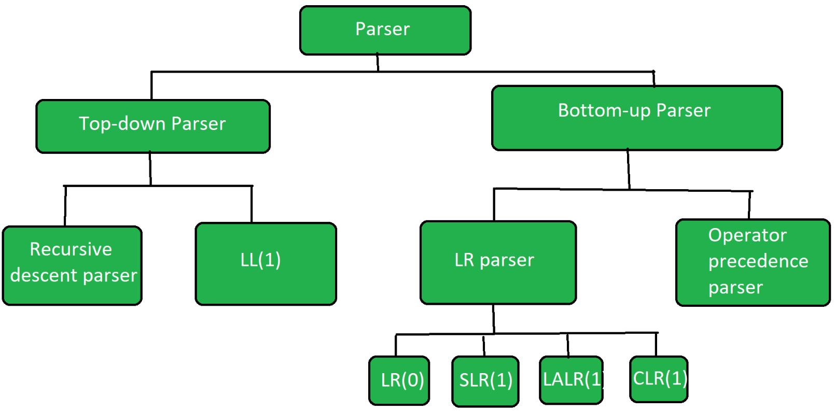
Parsing Techniques (Contd.)

Slide 23
Top-Down Parser
Top-down parsing begins at the root of the parse tree and works its way down to the leaves.
It attempts to construct the parse tree by expanding non-terminal symbols into their corresponding productions according to the grammar rules.
Top-Down Parsing begins from the start symbol of the grammar and tries to derive the input string by expanding production rules.
This method uses the recursive application of grammar rules and builds the parse tree from the root down to the leaves.
Further Top-down parser is classified into 2 types: 1) Recursive descent parser and 2) non-recursive descent parser.

Slide 24
Top-Down Parser – Recursive Descent Parsing
Recursive descent parsing involves writing a set of recursive functions for each non-terminal in the grammar.
It attempts to match the input string against the grammar in a depth-first manner.
This technique involves creating a set of recursive functions, where each function corresponds to a non-terminal in the grammar.
The function calls itself to parse non-terminals, making it intuitive but susceptible to issues like left recursion and backtracking.
Recursive descent parser is also known as the Brute force parser or the backtracking parser. It basically generates the parse tree by using brute force and backtracking techniques.

Slide 25
Recursive Descent Parsing – with Backtracking
Definition: A backtracking parser tries each possible production for a non-terminal until it finds one that successfully parses the input.
How it Works: If a production rule does not lead to a successful parse, it "backtracks" and tries another rule.
Disadvantage: Backtracking is inefficient because it can lead to multiple re-evaluations of the same input, resulting in exponential time complexity. It's not used in practical parsers.

Slide 26
Predictive Parsing
A predictive parser is a recursive descent parser without backtracking or backup.
It is a top-down parser that does not require backtracking. At each step, the choice of the rule to be expanded is made upon the next terminal symbol.
Predictive parsing solves the inefficiency of backtracking by using lookahead tokens to determine the correct production rule to apply, without trying all possibilities.
How it Works: The parser uses the next input symbol (lookahead) to make decisions about which production to use. This is done by constructing a parsing table that maps a combination of non-terminals and lookahead tokens to a production rule.
https://www.geeksforgeeks.org/predictive-parser-in-compiler-design/?ref=ml_lbp

Slide 27
Predictive Parsing – LL(1) Parsing
LL Parsing stands for Left-to-right scanning of the input, producing a Leftmost derivation of the input string.
Definition: The most common form of LL parsing is LL(1), where “1” represents one lookahead token.
How it Works: The parser makes decisions based on a single token of lookahead. The grammar must be free from left recursion and must not have common prefixes (this requires grammar transformations such as left-factoring and eliminating left recursion).
Efficiency: LL(1) parsing is efficient and easy to implement, but it can only parse LL(1) grammars, which are relatively restrictive.
https://www.geeksforgeeks.org/ll1-parsing-algorithm/

Slide 28
Bottom-Up Parser
Bottom-up parsing starts with the input tokens and attempts to construct the parse tree by applying reverse production rules.
It recognizes strings of terminals and reduces them to non-terminals.
Bottom-Up Parsing works by starting with the input and attempting to construct the parse tree from the leaves (i.e., input tokens) upward, reducing the input string to the start symbol.
Bottom-up Parser is the parser that generates the parse tree for the given input string with the help of grammar productions by compressing the terminals.
It starts from terminals and ends upon the start symbol. It uses the rightmost derivation in reverse order.

Slide 29
Bottom-Up Parser – Operator Precedence Parsing
Operator-precedence parsing is used specifically for expressions that involve operators with defined precedence (e.g., arithmetic expressions). It’s a simpler, faster alternative to LR parsing when dealing with such grammars.
How it Works:
The parser uses a precedence table to determine the precedence and associativity of operators.
When parsing an expression, the parser shifts operators and operands onto a stack.
If the precedence of the current operator is lower than or equal to the operator on the top of the stack, the parser reduces the stack by applying the operator.
Advantages:
Efficient for parsing arithmetic expressions.
Easy to implement for simple expressions.
Limitations: It can only handle grammars where precedence relationships are well-defined. It’s unsuitable for general-purpose parsing tasks.

Slide 30
Bottom-Up Parser – LR Parsing
LR parsing is the most powerful type of shift-reduce parsing. LR parsers are capable of recognizing a large class of context-free grammars, including those that LL parsers cannot handle.
LR parser is a bottom-up parser for context-free grammar that is very generally used by computer programming language compiler and other associated tools.
LR parser reads their input from left to right and produces a right-most derivation. It is called a Bottom-up parser because it attempts to reduce the top-level grammar productions by building up from the leaves.
LR parsers are the most powerful parser of all deterministic parsers in practice.

Slide 31
LR Parsing (Contd.)
The term parser LR(k) parser, here the L refers to the left-to-right scanning, R refers to the rightmost derivation in reverse and k refers to the number of unconsumed “look ahead” input symbols that are used in making parser decisions. Typically, k is 1 and is often omitted.
A context-free grammar is called LR (k) if the LR (k) parser exists for it.
This first reduces the sequence of tokens to the left. But when we read from above, the derivation order first extends to non-terminal.

Slide 32
LR Parsing (Contd.)
This first reduces the sequence of tokens to the left. But when we read from above, the derivation order first extends to non-terminal.
The stack is empty, and we are looking to reduce the rule by S’→S$.
Using a “.” in the rule represents how many of the rules are already on the stack.
A dotted item, or simply, the item is a production rule with a dot indicating how much RHS has so far been recognized.

Slide 33
LR Parsing (Contd.)
Rules for LR parser :
The rules of LR parser as follows.
(A)The first item from the given grammar rules adds itself as the first closed set.
(B)If an object is present in the closure of the form A→ α. β. γ, where the next symbol after the symbol is non-terminal, add the symbol’s production rules where the dot precedes the first item.
(C)Repeat steps (B) and (C) for new items added under (B).

Slide 34
LR Parsing(Contd.)
For LR parsing algorithm refer to:
https://www.geeksforgeeks.org/lr-parser/
https://youtu.be/SejqKlKgOnk?si=NBk1i0DxTZ0p0ARt
For Example of LR parsing refer to:
https://www.geeksforgeeks.org/problem-on-lr0-parser/?ref=ml_lbp

Slide 35
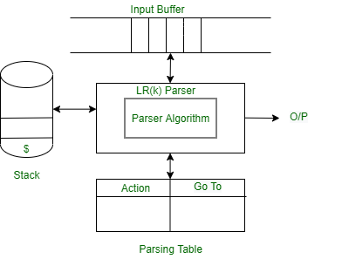
LR Parsing (Contd.)

Slide 36
Types of LR Parsing Techniques
SLR (Simple LR) Parsing
https://www.geeksforgeeks.org/slr-parser-with-examples/?ref=ml_lbp
Definition: SLR parsing is a simplified version of LR parsing. It uses the follow sets of non-terminals to make decisions during the reduce phase.
How it Works:
States are constructed based on LR(0) items, which represent the positions in the grammar rules where reductions can occur.
The parser uses a lookahead token and a set of rules to determine whether to shift or reduce.
Advantages:
It is simpler and requires smaller parsing tables than more advanced LR parsers.
However, it cannot handle all LR(1) grammars, particularly when grammar ambiguities arise.

Slide 37
Types of LR Parsing Techniques (Contd.)
LALR (Look-Ahead LR) Parsing
Definition: LALR parsing is the most commonly used form of LR parsing in practice. It stands for Look-Ahead LR parsing and uses lookahead tokens to resolve parsing conflicts.
How it Works:
LALR parsers merge states that are identical except for lookahead sets, reducing the number of states compared to canonical LR parsers.
The lookahead token helps to decide whether to shift or reduce at a given point.
Advantages:
LALR parsers require smaller tables and are more efficient than full LR parsers.
They are commonly used in tools like Yacc (Yet Another Compiler-Compiler).
Limitations: LALR parsers can still fail on certain complex grammars that canonical LR parsers can handle, but these cases are rare in practice.

Slide 38
Types of LR Parsing Techniques (Contd.)
CLR (Canonical LR) Parsing
Definition: Canonical LR parsing is the most general form of LR parsing. It uses full LR(1) item sets, which include lookahead information for every item.
How it Works:
States are constructed based on LR(1) items, which contain both the position in the grammar and a lookahead token.
CLR parsers can handle all context-free grammars that are LR(1), making them the most powerful of the LR parsers.
Advantages:
CLR parsers can handle any LR(1) grammar, including those with complex conflicts that SLR or LALR parsers cannot resolve.
Disadvantages:
The main drawback is that they require larger parsing tables and more memory, which can make them inefficient for large grammars.

Slide 39
Code Optimization Techniques
Code optimization is a crucial part of compiler design and system software development.
It involves transforming code to improve its efficiency without changing its functionality.
Code optimization aims to enhance performance by reducing execution time, memory usage, or power consumption.
In the context of compilers, optimization can happen at various stages, primarily during or after intermediate code generation.
Optimizations can be machine-independent or machine-dependent.

Slide 40
Code Optimization Techniques (Contd.)
Types of Code Optimization Techniques
Code optimization techniques can be broadly classified into two categories:
Machine-independent optimizations: These are optimizations that do not depend on the target machine architecture and focus on improving the quality of intermediate code.
Machine-dependent optimizations: These optimizations rely on specific details of the target machine, such as instruction sets or memory hierarchy, to improve the final machine code.

Slide 41
Code Optimization Techniques (Contd.)
Machine-independent Optimizations
Machine-independent optimizations are performed on intermediate code and are applicable across various machine architectures. These optimizations focus on improving the quality of the code at a higher level. Key techniques include:
a. Constant Folding
Definition: Constant folding is an optimization where compile-time constants are evaluated and replaced in the code.
Example: If the expression 3 + 4 appears in the source code, it is replaced by 7 during compilation.
Benefits: Reduces the number of computations that need to be performed at runtime, resulting in faster code execution.

Slide 42
Code Optimization Techniques (Contd.)
b. Constant Propagation
Definition: Constant propagation replaces the value of a variable when it is known to be constant.
Example: If a variable x is assigned a constant value x = 5, then in subsequent occurrences of x, the value 5 is used instead of the variable.
Benefits: Reduces unnecessary variable lookups and allows for further optimizations like constant folding.

Slide 43
Code Optimization Techniques (Contd.)
c. Dead Code Elimination
Definition: Dead code elimination removes parts of the code that are never executed or do not affect the program’s output.
Example: If a variable is assigned a value that is never used, the assignment is removed.
Benefits: Reduces the size of the code, which can improve both runtime performance and memory usage.

Slide 44
Code Optimization Techniques (Contd.)
d. Common Subexpression Elimination (CSE)
Definition: CSE eliminates redundant calculations by reusing the results of previously computed expressions.
Example: In the code a = b + c; d = b + c;, the second occurrence of b + c is redundant, and the result from the first computation can be reused.
Benefits: Reduces redundant computations, improving the execution speed of the program.

Slide 45
Code Optimization Techniques (Contd.)
e. Loop Optimizations
Loop optimizations are particularly important for improving the performance of programs, as loops are often executed many times. Key loop optimizations include:
i. Loop Invariant Code Motion
Definition: Moves code that does not change within a loop (loop-invariant code) outside of the loop.
Example: If a computation inside a loop is independent of the loop variable, it can be moved outside the loop to avoid redundant computation.
Benefits: Reduces the number of instructions inside the loop, improving loop execution speed.

Slide 46
Code Optimization Techniques (Contd.)
ii. Loop Unrolling
Definition: Loop unrolling replicates the loop body multiple times to decrease the loop control overhead.
Example: Instead of running a loop 10 times with a single iteration body, the loop body is replicated 2 times, and the loop is run 5 times.
Benefits: Reduces loop control operations (such as incrementing counters and checking conditions), which can result in faster execution.

Slide 47
Code Optimization Techniques (Contd.)
ii. Loop Fusion
Definition: Combines two adjacent loops that iterate over the same range into a single loop.
Example: Two loops iterating over the same array can be merged into one loop to reduce loop overhead.
Benefits: Reduces loop overhead and improves cache locality, enhancing performance.

Slide 48
Code Optimization Techniques (Contd.)
f. Code Motion
Definition: Code motion moves statements from a frequently executed part of the code (like a loop) to a less frequently executed part (like outside the loop), provided it does not change the program’s behavior.
Example: A calculation inside a loop that does not depend on the loop variable can be moved outside the loop.
Benefits: Reduces the number of instructions in frequently executed paths, thereby speeding up execution.

Slide 49
Code Optimization Techniques (Contd.)
g. Strength Reduction
Definition: Strength reduction replaces an expensive operation with a computationally cheaper one without changing the program's outcome.
Example: Multiplications can be replaced by additions, or division by powers of two can be replaced by bit-shifting.
Benefits: Improves performance by using operations that are faster on most hardware architectures.

Slide 50
Code Optimization Techniques (Contd.)
Machine-dependent Optimizations
Machine-dependent optimizations are applied at the assembly or machine code level and take into account the specifics of the target machine architecture.
Machine-dependent code optimization techniques are designed to exploit specific features of the target machine's architecture, improving the efficiency of the generated machine code.
These optimizations focus on leveraging the hardware's capabilities to enhance performance, particularly by optimizing instruction selection, memory access, and CPU resource utilization.

Slide 51
Code Optimization Techniques (Contd.)
Register Allocation: Allocates variables to CPU registers to reduce memory access time, enhancing speed.
Instruction Scheduling: Reorders instructions to avoid pipeline stalls and data hazards in modern processors.
Instruction Selection: Chooses efficient machine instructions based on the architecture, optimizing performance.
Cache Optimization: Improves data locality to make better use of the CPU cache, reducing memory access time.
Instruction Combining: Merges multiple instructions into a single, more efficient operation when supported by the hardware.
Address Mode Optimization: Utilizes efficient addressing modes provided by the hardware to optimize memory access.

Slide 52


